Slide 1
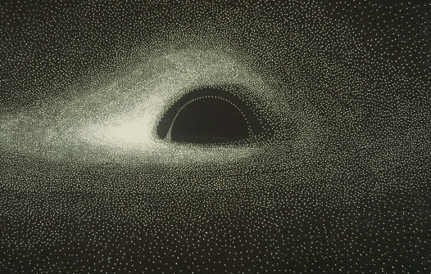
Hyper-Eddington accretion flows on to massive BHs
Kohei Inayoshi, Zoltán Haiman, Jeremiah P. Ostriker
(arXiv:1511.02116, Jul. 2016)
(Fig. Jean-Pierre Luminet, 1979)
Ana Lam Compact Objects Final May 20, 2025
Notes:
Hello! My name is Ana and today I am going to be discussing this paper that presents a solution for steady Hyper-Eddington accretion flows on to massive BHs. This work was done by Inayoshi, Haiman, and Ostriker and published in 2016.

Slide 2
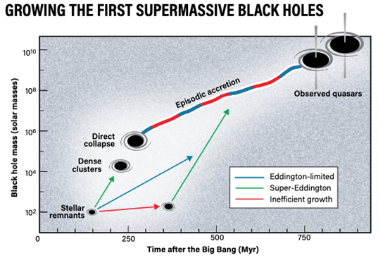
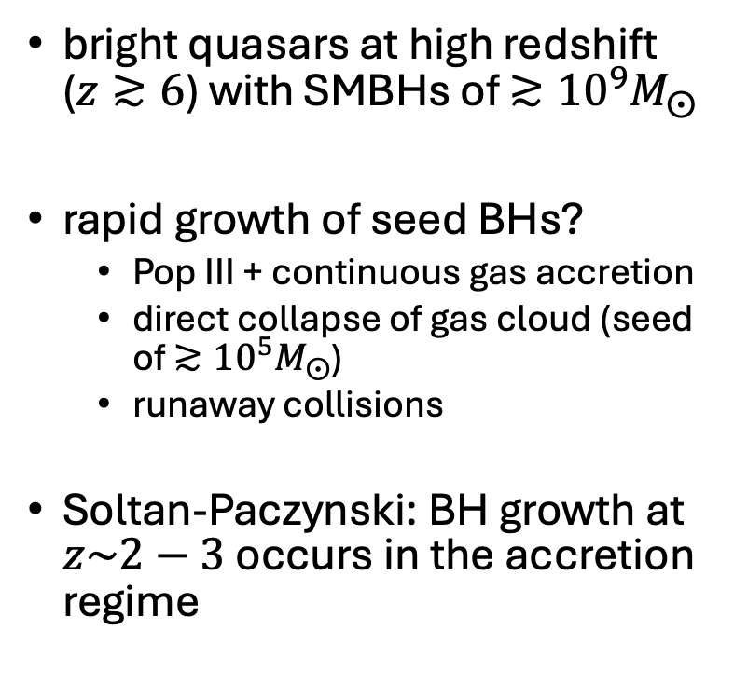
Motivation
bright quasars at high redshift ($z≳6$) with SMBHs of $≳{10}^{9}M_{⨀}$
rapid growth of seed BHs?
Pop III + continuous gas accretion
direct collapse of gas cloud (seed of $≳{10}^{5}M_{⨀}$)
runaway collisions
Soltan-Paczynski: BH growth at $z\sim 2−3$ occurs in the accretion regime
(Fig. Roen Kelly, after Smith & Bromm, 2019)
Notes:
The core motivation of this study lies in the recent detection of bright quasars at high redshift (like z~/> than 6) with SMBHs of greater than 10^9 solar masses. These SMBHs that were discovered from surveys like PANSTARR and SDSS and more proved a challenge as to how we got these huge black holes so early in cosmic history.
Redshift of 6/7 is about a billion years after the Big Bang. In order to get these specific SMBH masses you could need some combination of massive seeds or insane growth rates.
There are several candidate scenarios for how the first black hole seeds formed. If we are considering stellar evolution, perhaps our Pop III stars were massive like around 100 solar masses and left seeds of about the same mass. However, these remnants would have to grow at or beyond the Eddington limit almost continuously to be these SMBH seeds. A direct collapse scenario has also been proposed where you get a metal-free low-fragmentation gas cloud to directly collapse into a BH, yet these conditions are very specific. Or you might get many many collisions in dense stellar cluster environments that yield very massive stars that collapse into BHs of similar masses. This would require very high densities. This paper is motivated by the Soltan–Paczyncki argument which says the majority of BH growth at low redshift occurs in the accretion regime. So, the focus here is on accretion growth to get these SMBHs.

Slide 3
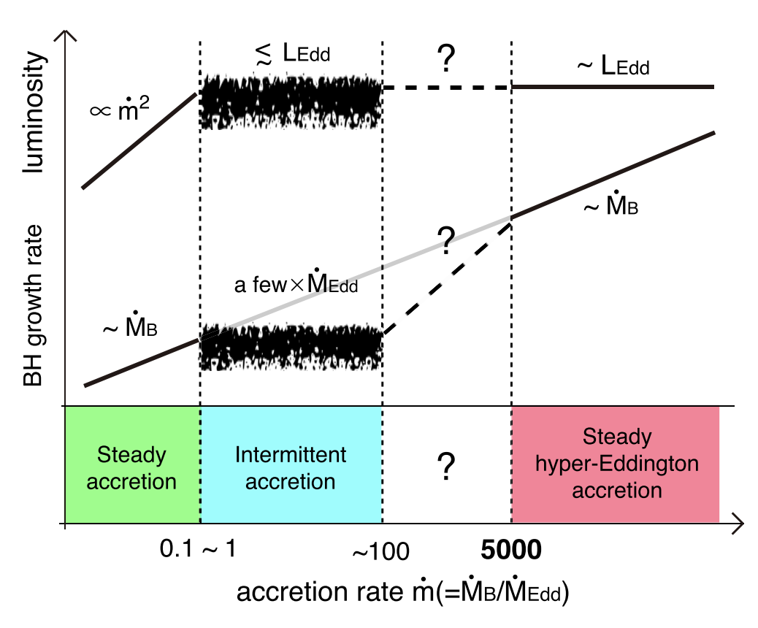
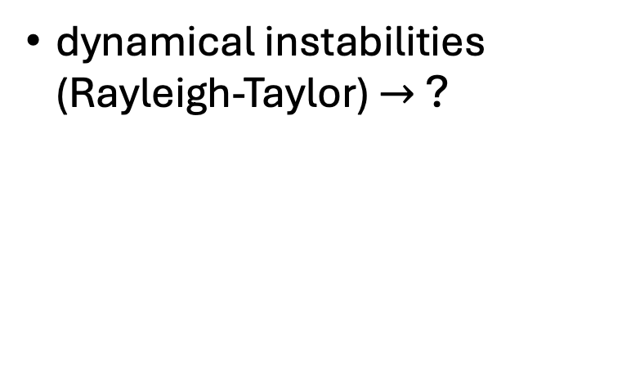
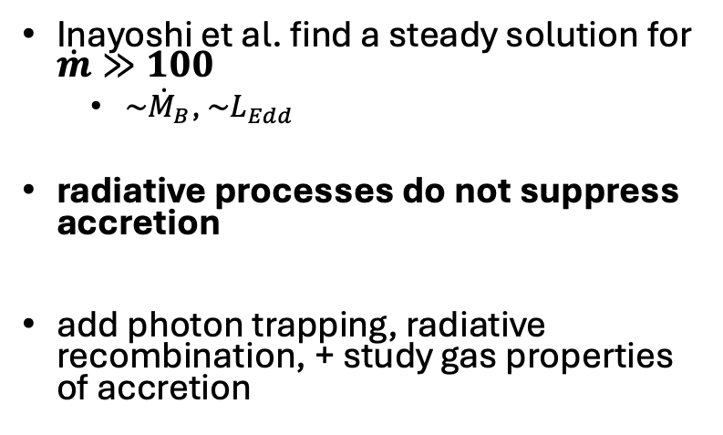
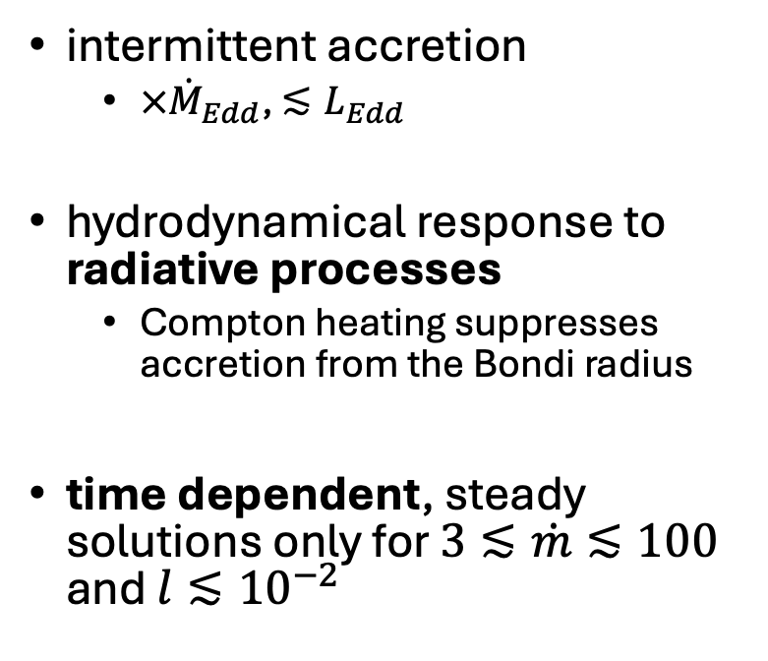
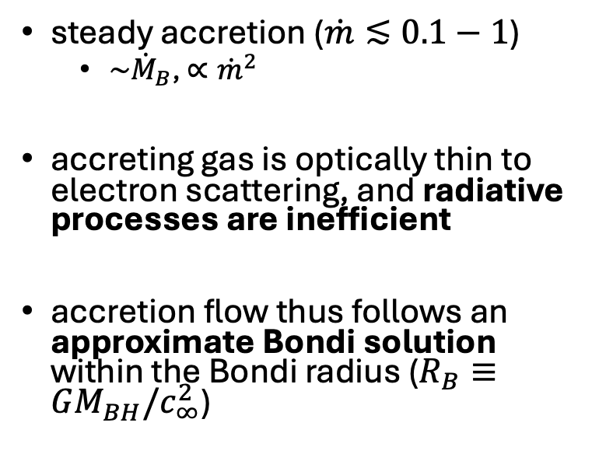
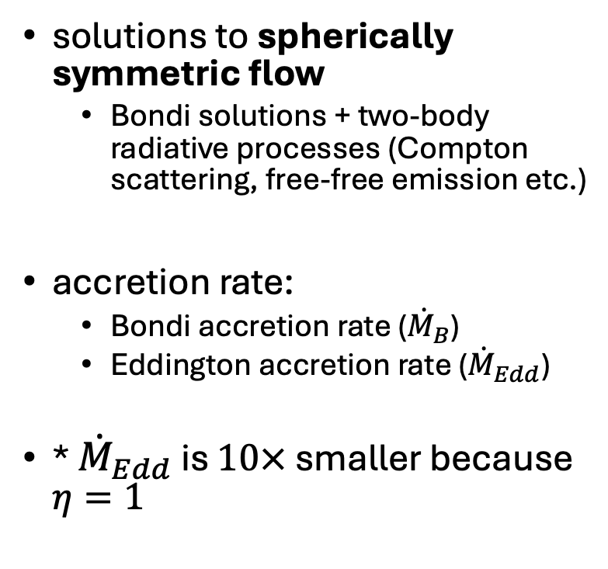
Previous BH Accretion Solutions
solutions to spherically symmetric flow
Bondi solutions + two-body radiative processes (Compton scattering, free-free emission etc.)
accretion rate:
Bondi accretion rate (${\dot{M}}_{B}$)
Eddington accretion rate (${\dot{M}}_{Edd}$)
* ${\dot{M}}_{Edd}$ is $10×$ smaller because $η=1$
intermittent accretion
$×{\dot{M}}_{Edd}$, $≲L_{Edd}$
hydrodynamical response to radiative processes
Compton heating suppresses accretion from the Bondi radius
time dependent, steady solutions only for $3≲\dot{m}≲100$ and $l≲{10}^{−2}$
steady accretion ($\dot{m}≲0.1−1$)
${\sim \dot{M}}_{B}$, $∝{\dot{m}}^{2}$
accreting gas is optically thin to electron scattering, and radiative processes are inefficient
accretion flow thus follows an approximate Bondi solution within the Bondi radius ($R_{B}≡GM_{BH}/c_{∞}^{2}$)
Inayoshi et al. find a steady solution for $\dot{m}≫100$
${\sim \dot{M}}_{B}$, $\sim L_{Edd}$
radiative processes do not suppress accretion
add photon trapping, radiative recombination, + study gas properties of accretion
dynamical instabilities (Rayleigh-Taylor) $→$ ?
Notes:
In order to start discussing the accretion solution proposed and explored in Inayoshi’s paper. I would like to first review previous work in this field. The Bondi solutions published in the 50s were the first solutions to spherically symmetric accretion onto compact objects. These solutions did not account for radiation, so future research applied two-body radiative processes such as Compton scattering, Bremsstrahlung. Across our different accretion solutions we will touch on Bondi accretion and Eddington limited accretion. Bondi accretion depends mainly on the gas pressure, gas sound speed, and mass of the BH while Eddington limited mass accretion is dependent on the luminosity. I want to note that this paper sets their radiative efficiency to 1 for their Eddington mass accretion.
For lower accretion rates, this is as a function of Bondi accretion. We get accretion that goes as Bondi and a luminosity proportional to the accretion rate squared. The gas is optically thin to electron scattering and radiative processes, such as heating and cooling, are inefficient.
At a higher accretion regime, the flow becomes unstable and burst/episodic like as radiation kicks in to suppress accretion at the Bondi radius. We reach here the Eddington limit.
Now this paper finds a steady hyper-Eddington accretion solution because of photon trapping. We get our mass accretion following Bondi again yet the luminosity is still Eddington limited.
The regime between 100-5000 is highly uncertain and according to the paper hydrodynamical instabilities such as the Rayleigh Taylor instability suppress accretion.

Slide 4
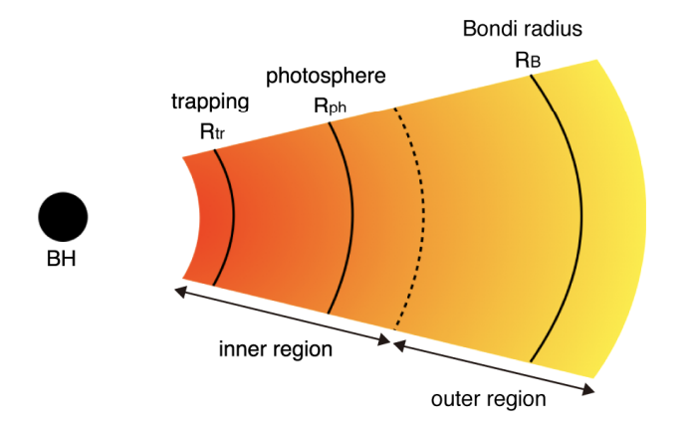
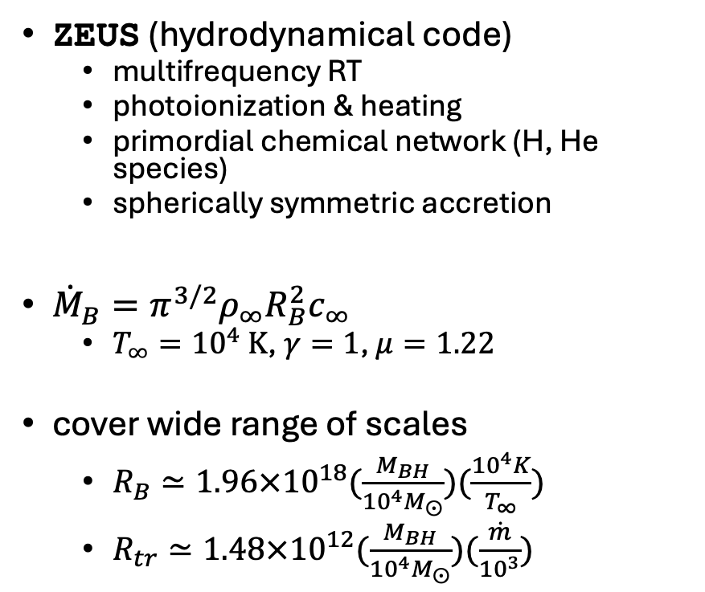
Simulation Set Up
ZEUS (hydrodynamical code)
multifrequency RT
photoionization & heating
primordial chemical network (H, He species)
spherically symmetric accretion
${\dot{M}}_{B}=π^{3/2}ρ_{∞}R_{B}^{2}c_{∞}$
$T_{∞}={10}^{4} \text{K}$, $γ=1$, $μ=1.22$
cover wide range of scales
$R_{B}≃1.96×{10}^{18}(\frac{M_{BH}}{{10}^{4}M_{⨀}})(\frac{{10}^{4}K}{T_{∞}})$
$R_{tr}≃1.48×{10}^{12}(\frac{M_{BH}}{{10}^{4}M_{⨀}})(\frac{\dot{m}}{{10}^{3}})$
Notes:
The simulation set up for Inayoshi et al is as follows. They do this in a hydrodynamical simulation that incorporates multifrequency radiative transfer, photoionization & heating, chemical reactions of hydrogen and helium species, and only consider spherically symmetric accretion (so this is 1D). This is much more detailed treatment than previous studies to fully capture how radiation pressure, heating and cooling processes can impact accretion flow.
Bondi accretion is as defined here, again only dependent on the gas properties and mass of the black hole. Or actually the Bondi radius describes the black hole mass. For this simulation they begin with a neutral uniform gas with a temperature of 10^4 kelvin, a specific heat of 1, and a mean molecular weight of 1.22
One thing to note is that they will simulate two regions of this problem separately because this process spans a wide range of scales. Specifically, they detail model an inner region to understand what happens at the trapping radius and an outer region to understand the accretion at the Bondi radius. In each of these regions different microphysics might dominate and impact the gas.

Slide 5
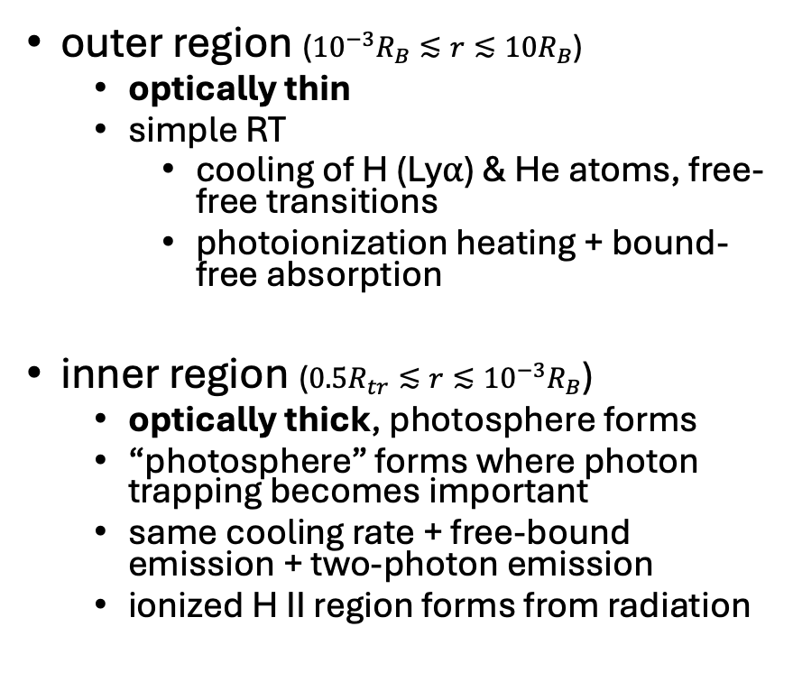
Simulation Set Up II
outer region (${10}^{−3}R_{B}≲r≲10R_{B}$)
optically thin
simple RT
cooling of H (Ly⍺) & He atoms, free-free transitions
photoionization heating + bound-free absorption
inner region ($0.5R_{tr}≲r≲{{10}^{−3}R}_{B}$)
optically thick, photosphere forms
“photosphere” forms where photon trapping becomes important
same cooling rate + free-bound emission + two-photon emission
ionized H II region forms from radiation
Notes:
The outer region which is spans some order of magnitudes around the Bondi radius is optically thin compared to the inner region. This region is important because here the gravitational attraction of the black hole begins to significantly impact the inflow of material. Again, the density is relatively low and optically thin.Here they do simple radiative transfer computations mainly cooling from hydrogen and helium cooling rates and free-free transitions, and heating from photoionization and bound-free absorption.
In the inner region, we have an optically thick environment. Inside the trapping radius the photon density is high and radiation pressure begins to dominate, impacting the flow. They focus on photon trapping and a sort of photosphere forms. Here we additionally consider free-bound and two-photon emission. Inayoshi et al also follow the formation of an ionized H II region in the inner region.

Slide 6
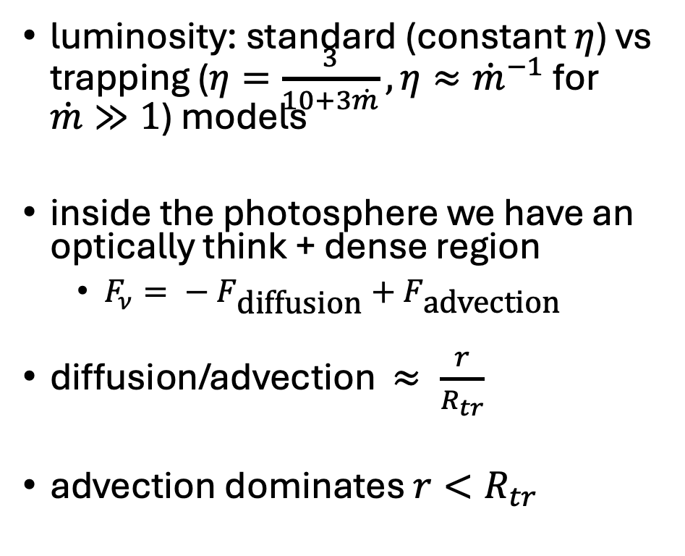
Trapping Model
luminosity: standard (constant $η$) vs trapping ($η=\frac{3}{10+3\dot{m}}, η≈{\dot{m}}^{−1}$ for $\dot{m}≫1$) models
inside the photosphere we have an optically think + dense region
$F_{ν}= {− F}_{\text{diffusion}}+F_{\text{advection}}$
diffusion/advection $≈ \frac{r}{R_{tr}}$
advection dominates $r<R_{tr}$
Notes:
Now the big addition in this simulation is the trapping model in that inner region. In standard radiation simulations we consider a constant radiative efficiency value. For this paper’s trapping model, the radiative efficiency depends on the mass accretion rate. For high mass accretion the radiative efficiency gets really inefficient as it becomes the inverse of mass accretion.
The flux in this “trap” is governed mainly by diffusion and advection. The relative magnitudes of these flux contributions depends on location in regards to the trapping radius. Inside the trap, or within the trapping radius advection dominates and most energy gets carried inward by the material being bulk transported in the accretion flow over being diffused out. This again limits the emergent luminosity.

Slide 7
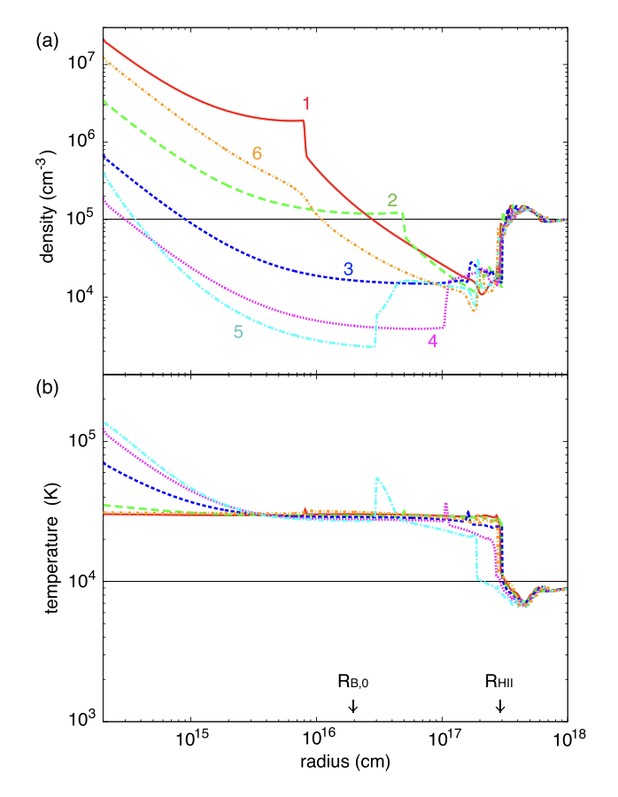
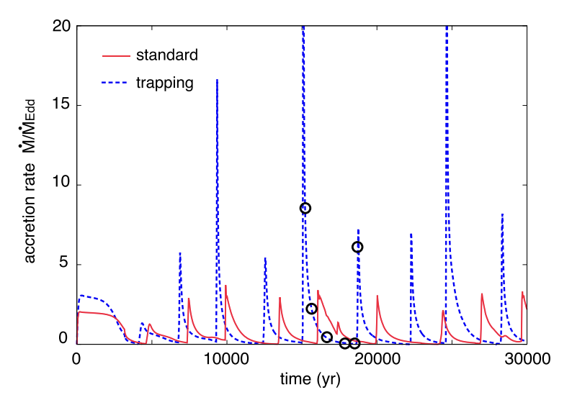

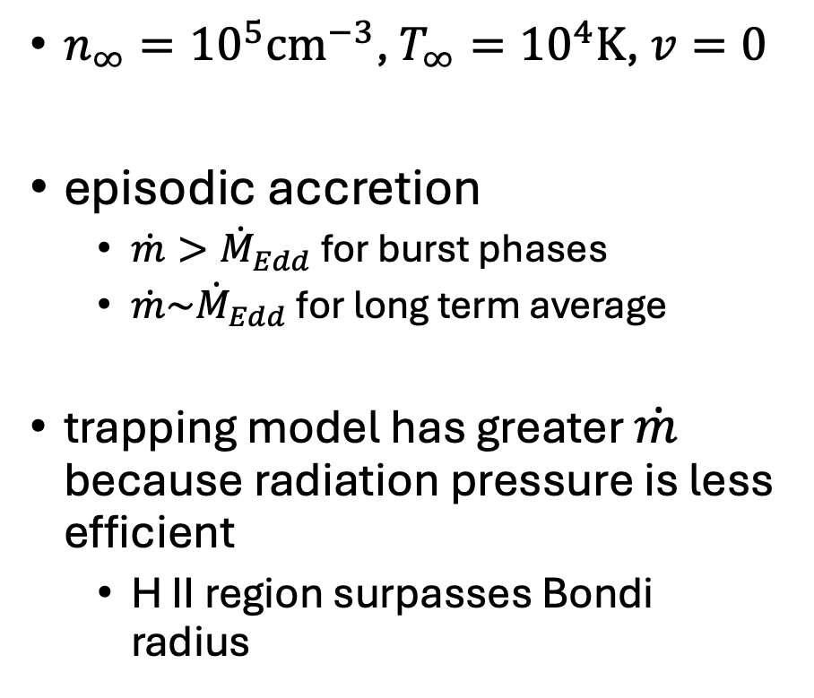
Results: Ordinary Stellar Remnant BH ($100M_{⨀}$)
$n_{∞}={10}^{5}{\text{cm}}^{−3}$, $T_{∞}={10}^{4}\text{K}$, $v=0$
episodic accretion
$\dot{m}>{\dot{M}}_{Edd}$ for burst phases
$\dot{m}\sim {\dot{M}}_{Edd}$ for long term average
trapping model has greater $\dot{m}$ because radiation pressure is less efficient
H II region surpasses Bondi radius
Notes:
Inayoshi et al first simulate an ordinary stellar remnant with a dense neutral uniform gas. Here they compare the standard model + their novel trapping model. For this 100 solar mass black hole, the accretion rate can get to very high values in the trapping model, however, the long term average is for the most part just a couple time the Eddington limited mass accretion rate. These bursts of high accretion rates are mainly due to the fact that we get that radiation inefficiencies due to the photon trapping. Furthermore, they point out for this case, that the H II region radius surpasses the Bondi radius, meaning the gas is going to be impacted by the radiative heating.

Slide 8
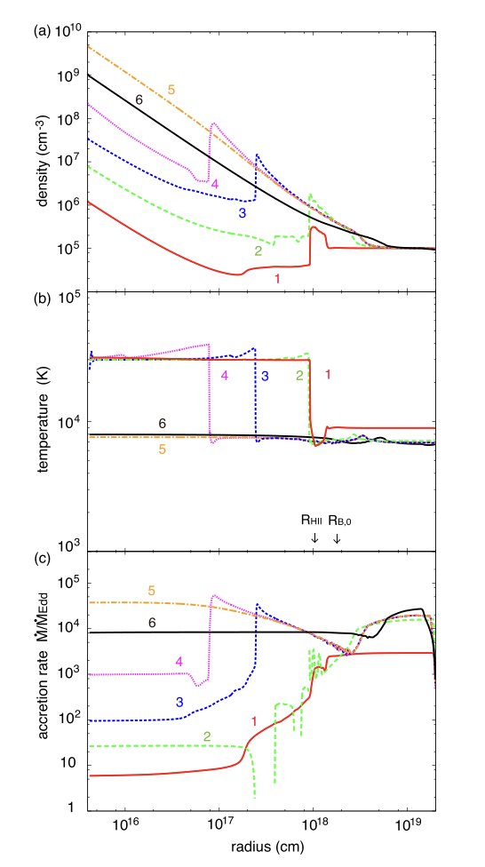
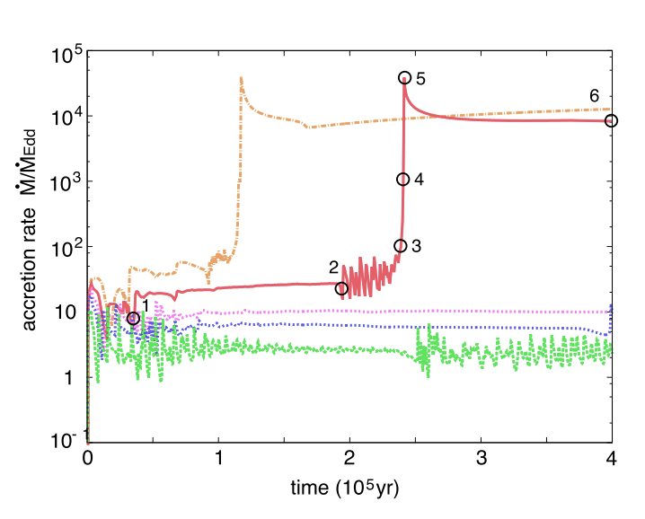
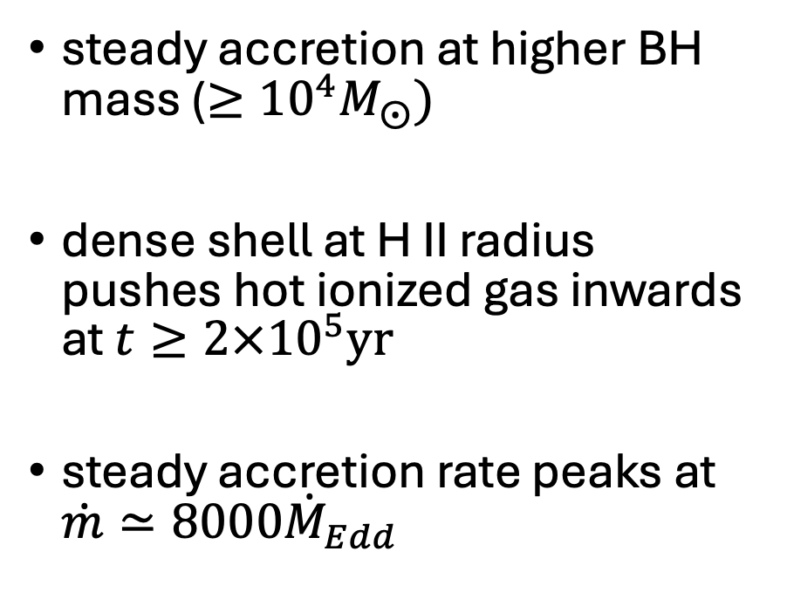
Results: Critical Accretion Rate (Higher BH mass)
steady accretion at higher BH mass ($≥{10}^{4}M_{⨀})$
dense shell at H II radius pushes hot ionized gas inwards at $t≥2×{10}^{5}\text{yr}$
steady accretion rate peaks at $\dot{m}≃8000{\dot{M}}_{Edd}$
$${10}^{3}M_{⨀} 3×{10}^{3}M_{⨀} 5×{10}^{3}M_{⨀}{ 10}^{4}M_{⨀} 2×{10}^{4}M_{⨀}$$
Notes:
But how about higher black hole masses? Can we get steady hyper-Eddington accretion then? Well, they do just that, they study masses from 10^3 solar masses to a couple of 10^4 solar masses. You can see that for BHs with masses greater than or equal to 10^4 solar masses we get pretty steady high accretion values. The reason for this is that the dense shell of the H II region pushes hot ionized gas inwards after 2*10^5 yrs (the radius of the H II region radius decreases). The peak of our accretion rate for these higher BH masses is about 8000 M dot Eddington.
As you can see here, the HII region radius is before the Bondi radius. So whatever diffuse energy is being manipulated way before the Bondi radius where the BH’s gravity is significant.

Slide 9
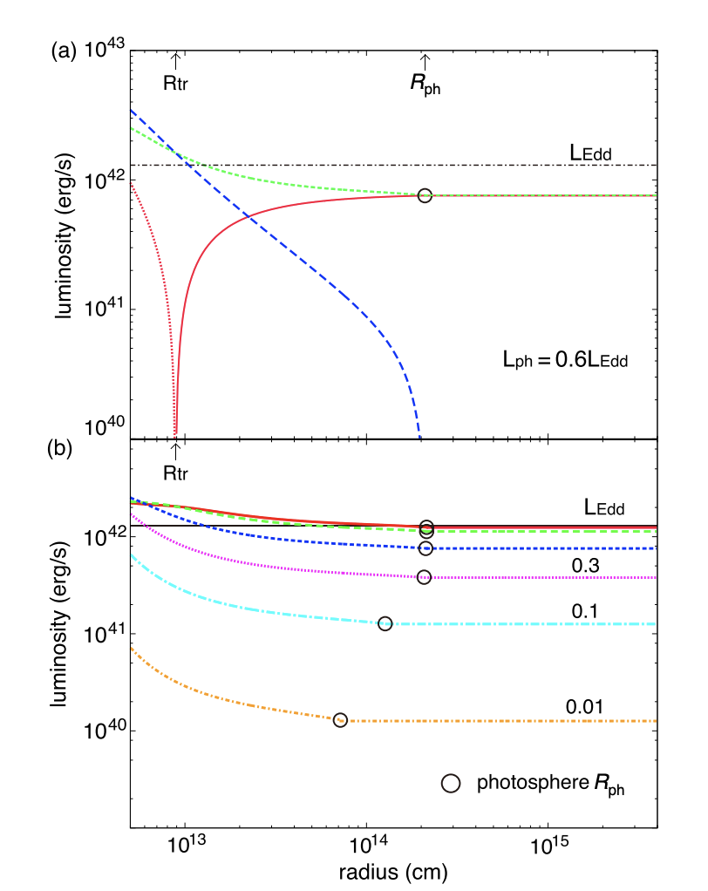
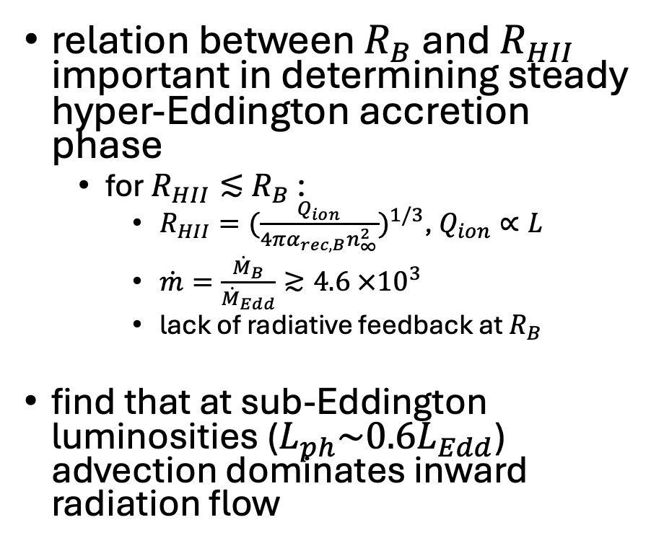

Analytic Argument + Inner Region Inflow
relation between $R_{B}$ and $R_{HII}$ important in determining steady hyper-Eddington accretion phase
for $R_{HII}≲$ $R_{B}$ :
$R_{HII}={(\frac{Q_{ion}}{4πα_{rec,B}n_{∞}^{2}})}^{1/3}$, $Q_{ion}∝L$
$\dot{m}=\frac{{\dot{M}}_{B}}{{\dot{M}}_{Edd}}≳4.6 ×{10}^{3}$
lack of radiative feedback at $R_{B}$
find that at sub-Eddington luminosities ($L_{ph}\sim 0.6L_{Edd}$) advection dominates inward radiation flow
$L_{\text{rest}} { L}_{\text{comoving}} { L}_{\text{advection}}$
Notes:
To further explicate this steady high accretion rate with the massive BHs. Inayoshi et al propose an analytic argument, determining that the relation between the Bondi radius and the H II region radius is important in this transition into a steady high accretion rate. Specifically, the H II region needs to be less than the Bondi radius in order to achieve the hyper-Eddington accretion phase. Here as you can see, the H II region is determined by this ionizing photon number flux which is proportional to the emergent luminosity. As long as this luminosity is sub-Eddington, which we do get because of the very inefficient radiative diffusion due to the trapping, advection dominates and we mainly get inward radiation flow. Furthermore, greater BH masses means greater Bondi radii.

Slide 10
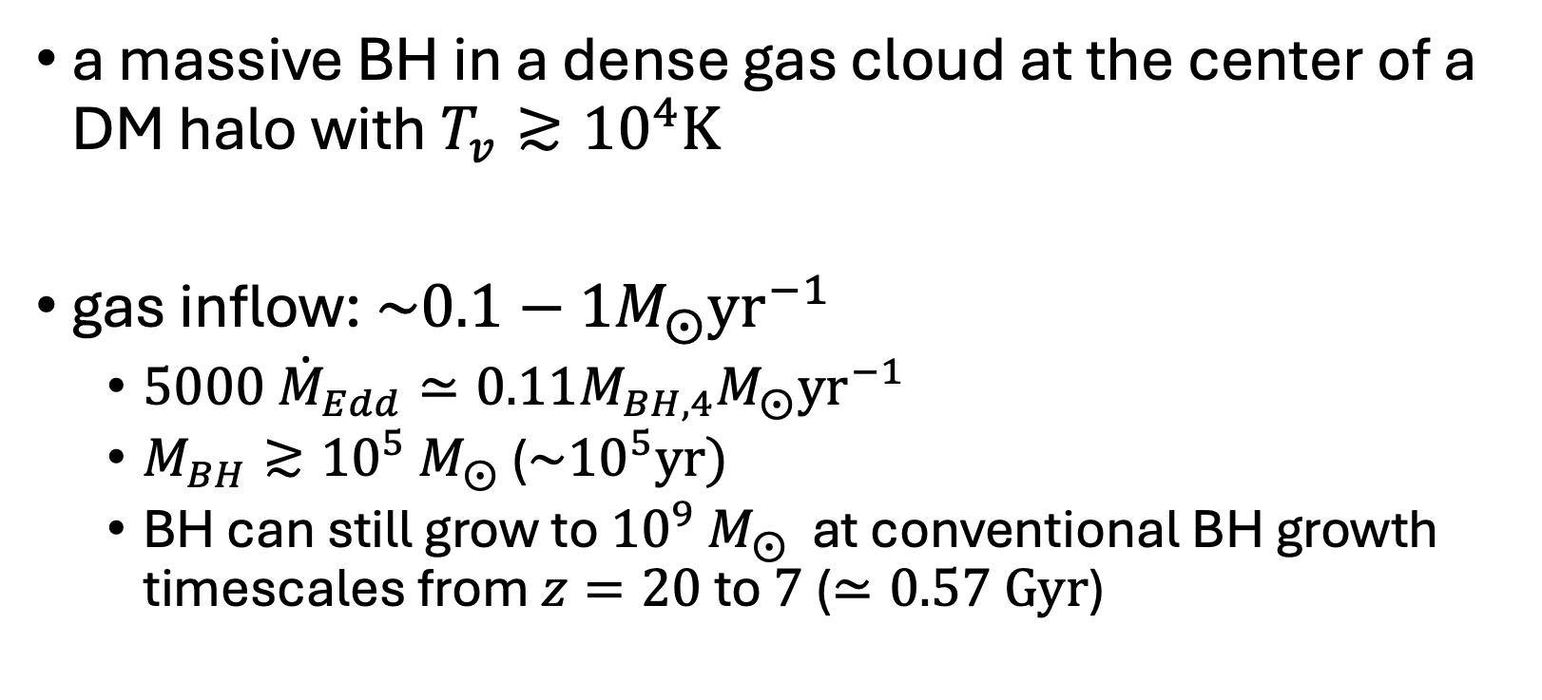
Implications for SMBH Seeds
a massive BH in a dense gas cloud at the center of a DM halo with $T_{v}≳{10}^{4}\text{K}$
gas inflow: $\sim 0.1−1M_{⨀}{\text{yr}}^{−1}$
$5000 {\dot{M}}_{Edd}≃0.11M_{BH,4}M_{⨀}{\text{yr}}^{−1}$
$M_{BH}≳{10}^{5}$ $M_{⨀}$ (${\sim 10}^{5}\text{yr}\text{)}$
BH can still grow to ${10}^{9}$ $M_{⨀}$ at conventional BH growth timescales from $z=20$ to $7$ ($≃0.57 \text{Gyr}$)
Notes:
The paper considers this Hyper-Eddington solution for the original motivation of this paper, the SMBH seeds. They find that when they put these massive BHs in dense gas clouds with a virial temperature greater than about 10^4K they get a gas inflow of about 0.1 to 1 solar masses per year which is enough to sustain a Hyper-Eddington accretion phase which can lead a 10^4 solar mass BH to grow up to masses greater than 10^5 in the span of a 100000 years (this is the accretion phase timescale they found in their simulation).
This is all that is necessary because after this BHs can grow to 10^9 solar masses at conventional BH growth timescales over 0.57 Gigayears.

Slide 11
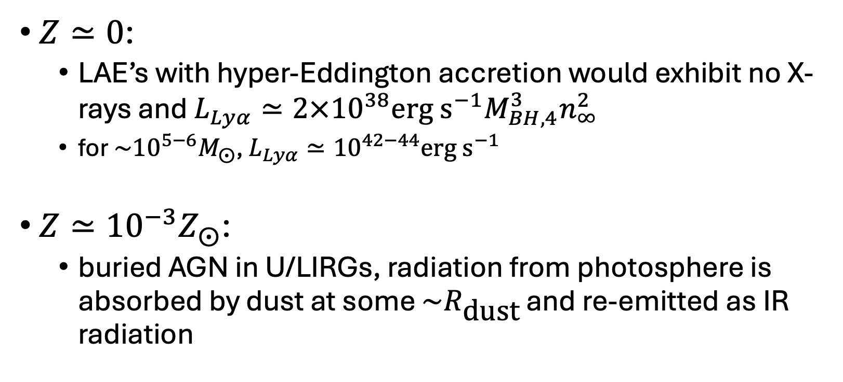
Observational Signatures
$Z≃0$:
LAE’s with hyper-Eddington accretion would exhibit no X-rays and $L_{Lyα}≃2×{10}^{38}\text{erg} {\text{s}}^{−1}M_{BH,4}^{3}n_{∞}^{2}$
for $\sim {10}^{5−6}M_{⨀}$, $L_{Lyα}≃{10}^{42−44}\text{erg} {\text{s}}^{−1}$
$Z≃{10}^{−3}Z_{⨀}$:
buried AGN in U/LIRGs, radiation from photosphere is absorbed by dust at some $\sim R_{\text{dust}}$ and re-emitted as IR radiation
Notes:
Inayoshi et al also discuss possible observational signatures of BHs accreting at the hyper-Eddington regime. The two cases they discuss is with and without dust grains. For low metallicity, the accretion flow from BHs accreting at this regime would be a bright Lyman Alpha emission source.
In high-redshift galaxies, lyman alpha emitters (young, low-mass, star-formation) galaxies have strong Lyman alpha emission whose origins remain uncertain. For the hyper-Eddington scenario, LAEs would exhibit no X-rays which tracks with the high-energy photons being trapped in the photon trapping effect of this scenarios. They argue that the associated Lyman alpha emission will be detectable by JWST.
For environments polluted by dust grains, so with slight metallicity, the radiation from the photosphere is absorbed and re-emitted as IR radiation. They propose this as the explanation for luminous infrared galaxies with buried AGN.

Slide 12
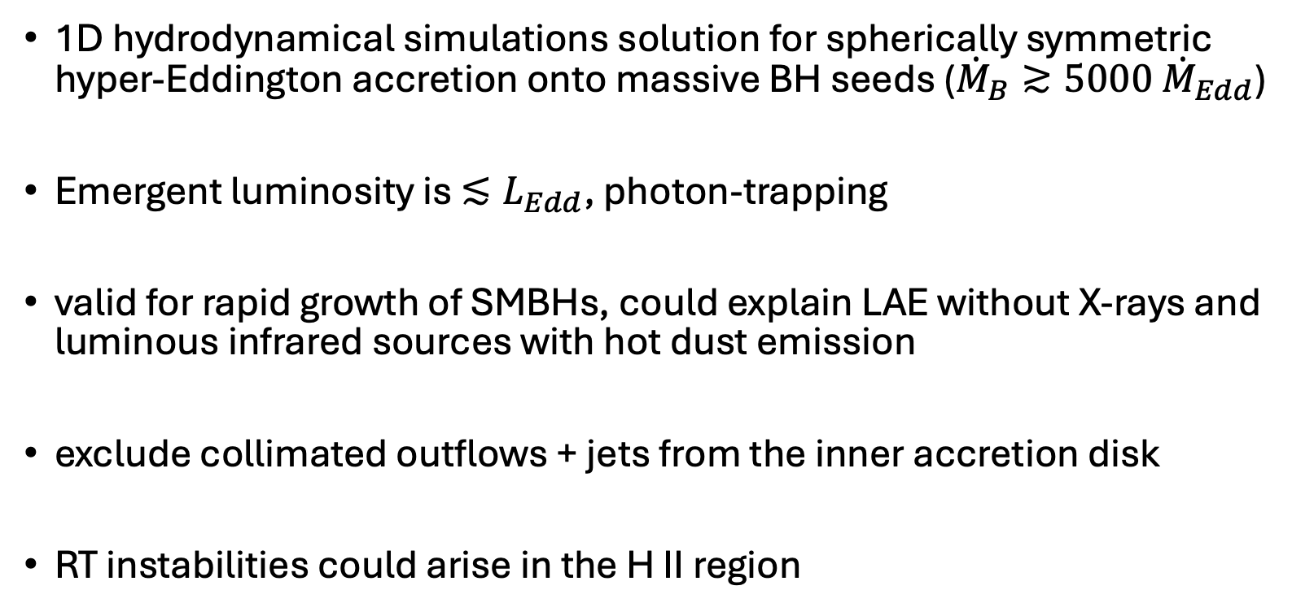
Summary + Caveats
1D hydrodynamical simulations solution for spherically symmetric hyper-Eddington accretion onto massive BH seeds (${\dot{M}}_{B}≳5000 {\dot{M}}_{Edd}$)
Emergent luminosity is $≲L_{Edd}$, photon-trapping
valid for rapid growth of SMBHs, could explain LAE without X-rays and luminous infrared sources with hot dust emission
exclude collimated outflows + jets from the inner accretion disk
RT instabilities could arise in the H II region
Notes:
Inayoshi et al present a steady hyper-Eddington accretion onto massive BH seeds solution via 1D hydrodynamical simulations for spherically symmetric accretion
They demonstrate that in the steady hyper-Eddington regime, which requires massive values of mass accretion, the emergent luminosity is Eddington limited because of the photon-trapping phenomena.
They also discuss this as a valid rapid growth of SMBHs mechanism, and discuss how this might explain LAEs without X-ray emission and Luminous infrared galaxies with hot dust emission
However, where this paper does fall short is that this is of course a 1D study. They exclude collimated outflows and jets from the inner accretion disk which could suppress accretion. Also they do not consider instabilities that could arise in the super dense, advection dominated, ionized hydrogen region which can also suppress accretion.

Slide 13
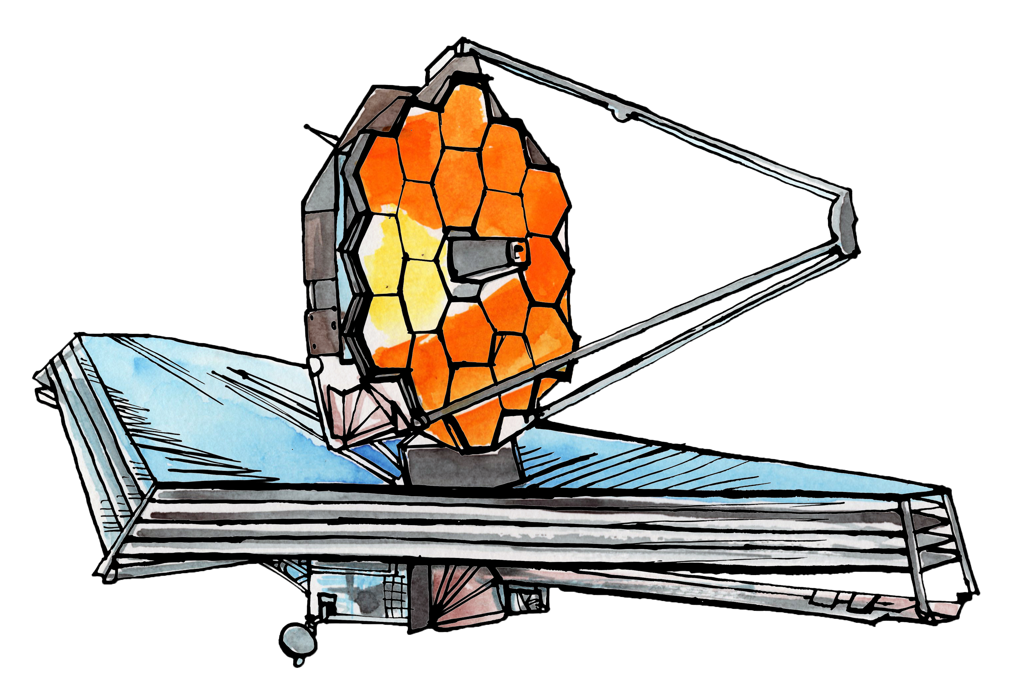
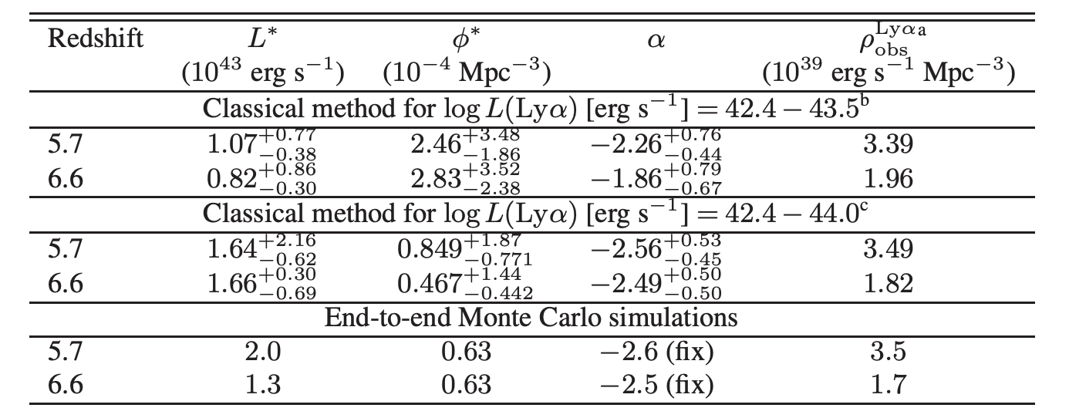
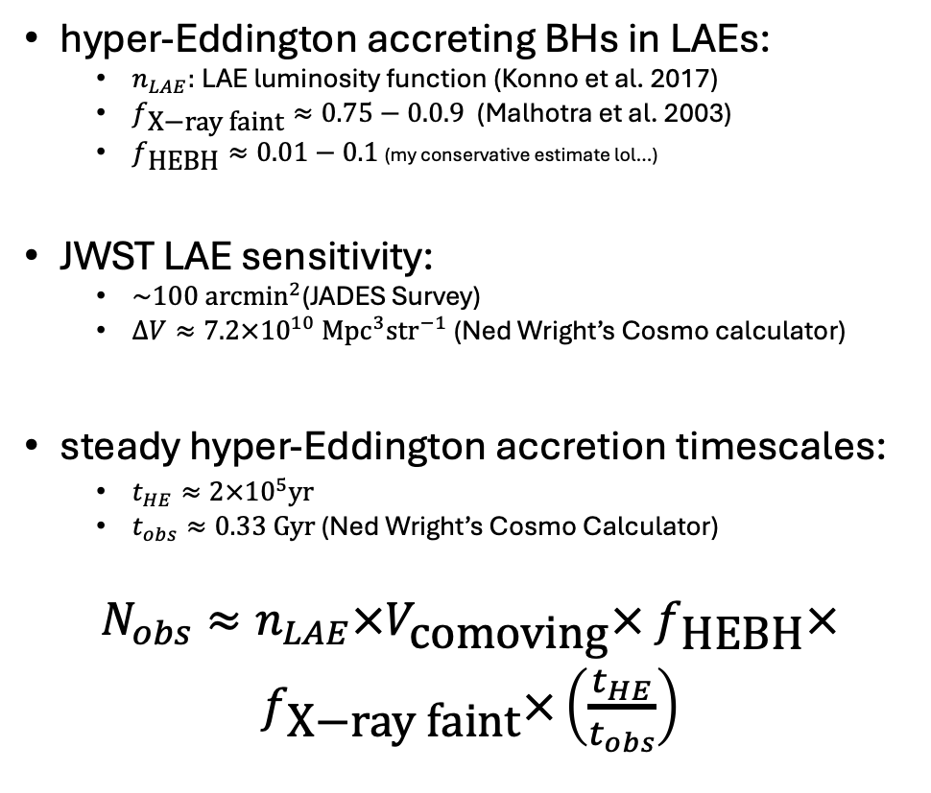
Fermi Problem: How many hyper-Eddington BHs could we possibly observe with JWST?
hyper-Eddington accreting BHs in LAEs:
$n_{LAE}:$LAE luminosity function (Konno et al. 2017)
$f_{\text{X}\text{−}\text{ray} \text{faint}}≈0.75−0.0.9$ (Malhotra et al. 2003)
$f_{\text{HEBH}}≈0.01−0.1$ (my conservative estimate lol…)
JWST LAE sensitivity:
$\sim 100 {\text{arcmin}}^{2}$(JADES Survey)
$∆V≈7.2×{10}^{10} {\text{M}\text{pc}}^{3}{\text{str}}^{−1}$ (Ned Wright’s Cosmo calculator)
steady hyper-Eddington accretion timescales:
$t_{HE}≈2×{10}^{5}\text{yr}$
$t_{obs}≈0.33 \text{Gyr}$ (Ned Wright’s Cosmo Calculator)
$N_{obs}≈n_{LAE}×V_{\text{comoving}}×$ $f_{\text{HEBH}}×f_{\text{X}\text{−}\text{ray} \text{faint}}×\left(\frac{t_{HE}}{t_{obs}}\right)$
Notes:
For my Fermi problem, I wanted to do another Drake-like equation about the observability of such a system since I’m a pop synth researcher and the idea of rates is mainly on my mind. Unlike for my midterm presentation where the paper laid out the equation. I had to formulate my own. I decided to focus on hyper-Eddington accreting BHs that could be the source of the LAE that can be observed by JWST. So in order to do this I had to first construct a luminosity function for lyman alpha emitters using the best fit parameters from a paper by Konno et al 2017. I also introduced a factor for the portion of Lyman alpha emitters that are X-ray faint from Malhotra’s 2003 paper. And I took a pretty conservative estimate to the fraction of LAEs that would host a hyperEddington accreting BH. Remember this only happens for BHs with masses equal to or greater than 10^4 solar masses. So I cautiously decided this would be 1 to 10% of host LAEs.
Now I also have to consider JWST LAE sensitivity. I decided to do research on the JADES Survey that focuses on high red shift. I took an estimate of their survey area and a comoving volume between z 6.7 and 6.5.
Another factor in this prediction will be the accretion timescales. From the paper I grabbed the steady accretion timescale to be a couple 100.000 years and the observing timescale to be the time between 6.7 and 6.5.
Here is my equation.

Slide 14
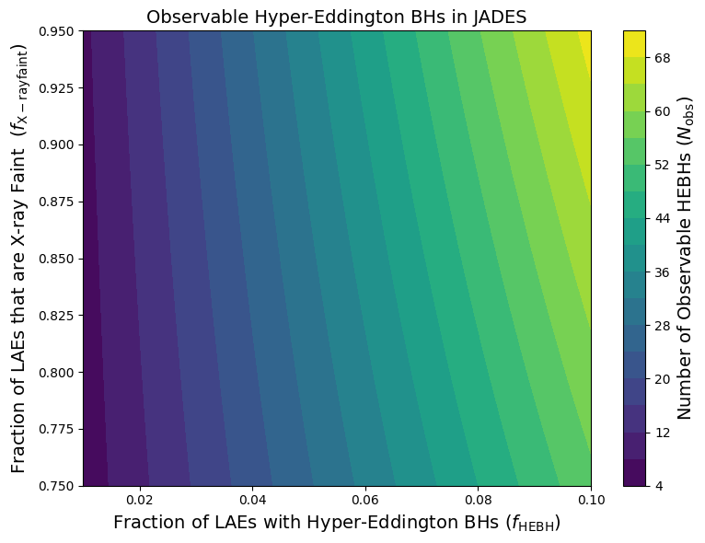
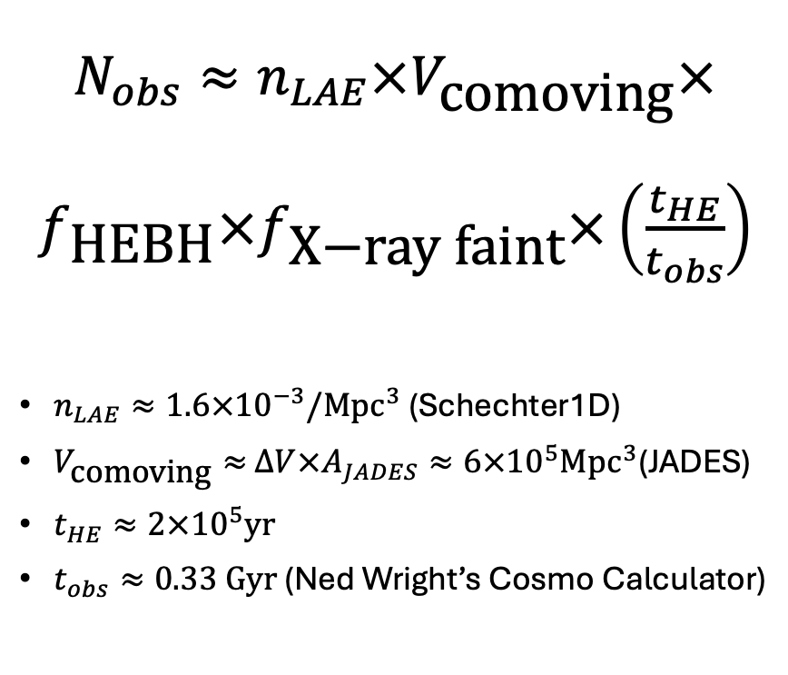
Fermi Problem: How many hyper-Eddington BHs could we possibly observe with JWST?
$N_{obs}≈n_{LAE}×V_{\text{comoving}}×$ $f_{\text{HEBH}}×f_{\text{X}\text{−}\text{ray} \text{faint}}×\left(\frac{t_{HE}}{t_{obs}}\right)$
$n_{LAE}≈1.6×{10}^{−3}/{\text{Mpc}}^{3}$ (Schechter1D)
$V_{\text{comoving}}≈$ $∆V×A_{JADES}≈6×{10}^{5}{\text{Mpc}}^{3}$(JADES)
$t_{HE}≈2×{10}^{5}\text{yr}$
$t_{obs}≈0.33 \text{Gyr}$ (Ned Wright’s Cosmo Calculator)
Notes:
So after putting all those ingredients together, I decided to look over the parameter space of my biggest uncertainties. The fraction of LAEs that are X-ray faint and the fraction of LAE’s hosting a possible Hyper-Eddington BH. As you can see the detections can range from like 4 to something like 70 potential observable systems.

